Slide 1

University Institute of Engineering
DEPARTMENT OF COMPUTER SCIENCE & ENGINEERING
Bachelor of Engineering (Computer Science & Engineering)
Subject Name : Machine Learning
Subject Code: CST-316
Topic: Fitting in Machine Learning
Lecture-2.0
By :Er. Baljeet Kaur Nagra
DISCOVER . LEARN . EMPOWER

Slide 2
Course Outcomes
CO-1:Apply the basic concept of Machine learning and statistics learning to deal with real-life Problems.
CO-2: Understand different machine learning algorithms, as well as underlying theories the behind them.
CO-3: Select and apply the appropriate machine learning algorithm to solve problems of moderate complexity
CO-4: Interpret and evaluate models generated from data.
CO-5: Optimize the models learned and report on the expected accuracy that can be attained by applying the algorithms to a real-world problem.

Slide 3
Course Objectives
To understand the history and development of Machine Learning.
To provide a comprehensive foundation to Machine Learning and Optimization methodology with applications t.
To study learning processes: supervised and unsupervised, deterministic and statistical knowledge of Machine learners, and ensemble learning
To understand modern techniques and practical trends of Machine learning.

Slide 4
CONTENTS
Signal vs Noise
Goodness of Fit
Under fitting vs Overfitting
Bias-Variance Tradeoff
Errors
Under fitting-detection and prevention
Over fitting-detection and prevention
Performance Metrices

Slide 5
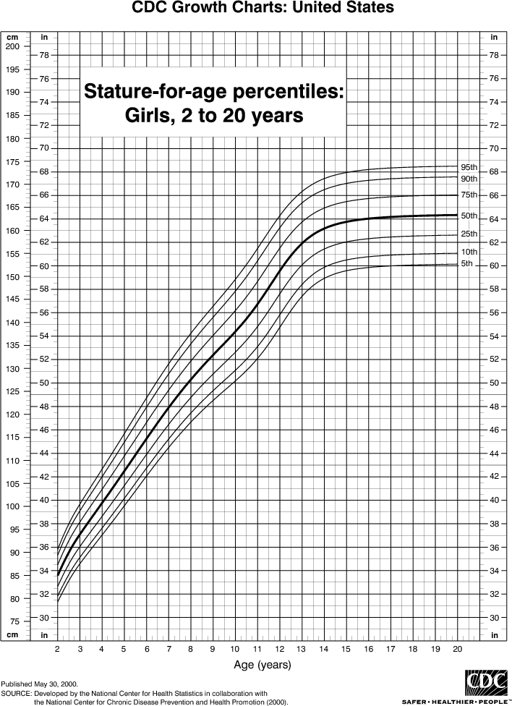
Signal vs Noise
In predictive modeling, you can think of the “signal” as the true underlying pattern that you wish to learn from the data.
“Noise,” on the other hand, refers to the irrelevant information or randomness in a dataset.
For example, let’s say you’re modeling height vs. age in children. If you sample a large portion of the population, you’d find a pretty clear relationship:
This is the signal.

Slide 6
Signal vs Noise
However, if you could only sample one local school, the relationship might be muddier. It would be affected by outliers (e.g. kid whose dad is an NBA player) and randomness (e.g. kids who hit puberty at different ages).
Noise interferes with signal.
Here’s where machine learning comes in. A well functioning ML algorithm will separate the signal from the noise.
If the algorithm is too complex or flexible (e.g. it has too many input features or it’s not properly regularized), it can end up “memorizing the noise” instead of finding the signal.
This overfit model will then make predictions based on that noise. It will perform unusually well on its training data… yet very poorly on new, unseen data.

Slide 7
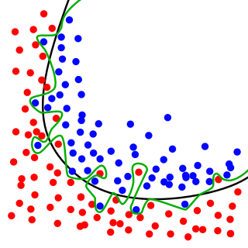
Goodness of Fit
Goodness of Fit
In statistics, goodness of fit refers to how closely a model’s predicted values match the observed (true) values.
A model that has learned the noise instead of the signal is considered “overfit” because it fits the training dataset but has poor fit with new datasets.
While the black line fits the data well, the green line is overfit.

Slide 8
Under fitting vs Over fitting
We can understand overfitting better by looking at the opposite problem, underfitting.
Underfitting occurs when a model is too simple – informed by too few features or regularized too much – which makes it inflexible in learning from the dataset.
Simple learners tend to have less variance in their predictions but more bias towards wrong outcomes .
On the other hand, complex learners tend to have more variance in their predictions.
Both bias and variance are forms of prediction error in machine learning.
Typically, we can reduce error from bias but might increase error from variance as a result, or vice versa.
This trade-off between too simple (high bias) vs. too complex (high variance) is a key concept in statistics and machine learning, and one that affects all supervised learning algorithms.

Slide 9
Bias Variance Tradeoff
The Bias-Variance Tradeoff is relevant for supervised machine learning - specifically for predictive modeling. It's a way to diagnose the performance of an algorithm by breaking down its prediction error.
In machine learning, an algorithm is simply a repeatable process used to train a model from a given set of training data.
here are 3 types of prediction error: bias, variance, and irreducible error.
Irreducible error is also known as "noise," and it can't be reduced by your choice in algorithm. It typically comes from inherent randomness, a mis-framed problem, or an incomplete feature set.
The other two types of errors, however, can be reduced because they stem from your algorithm choice.

Slide 10
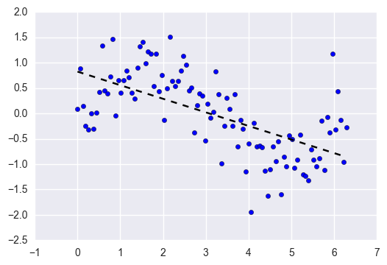
Error from Bias
Bias is the difference between your model's expected predictions and the true values.
That might sound strange because shouldn't you "expect" your predictions to be close to the true values? Well, it's not always that easy because some algorithms are simply too rigid to learn complex signals from the dataset.
Imagine fitting a linear regression to a dataset that has a non-linear pattern:
No matter how many more observations you collect, a linear regression won't be able to model the curves in that data! This is known as under-fitting.

Slide 11
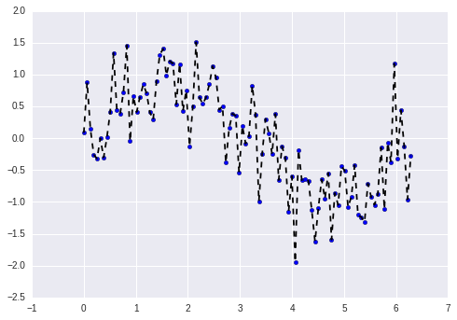
Error from Variance
Variance refers to your algorithm's sensitivity to specific sets of training data.
High variance algorithms will produce drastically different models depending on the training set.
For example, imagine an algorithm that fits a completely unconstrained, super-flexible model to the same dataset from above:
As you can see, this unconstrained model has basically memorized the training set, including all of the noise. This is known as over-fitting.

Slide 12
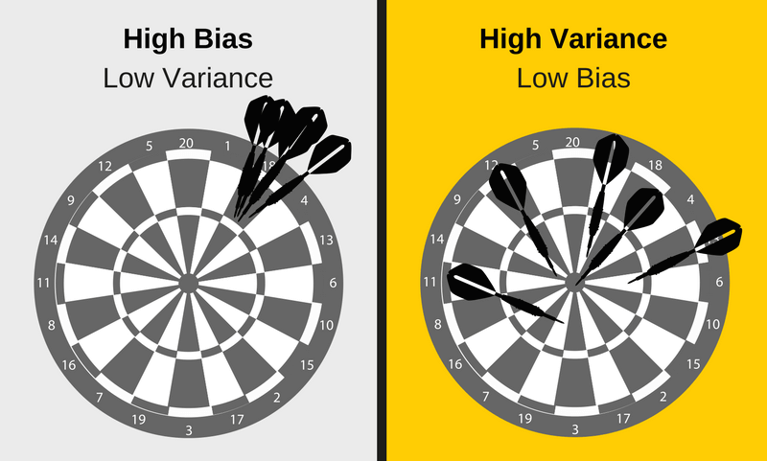
Bias Variance Tradeoff
Imagine you've collected 5 different training sets for the same problem.
Now imagine using one algorithm to train 5 models, one for each of your training sets.
Bias vs. variance refers to the accuracy vs. consistency of the models trained by your algorithm.
We can diagnose them as follows.

Slide 13
Bias Variance Tradeoff
Low variance (high bias) algorithms tend to be less complex, with simple or rigid underlying structure.
They train models that are consistent, but inaccurate on average.
These include linear or parametric algorithms such as regression and naive Bayes.
On the other hand, low bias (high variance) algorithms tend to be more complex, with flexible underlying structure.
They train models that are accurate on average, but inconsistent.
These include non-linear or non-parametric algorithms such as decision trees and nearest neighbors.
This tradeoff in complexity is why there's a tradeoff in bias and variance - an algorithm cannot simultaneously be more complex and less complex.

Slide 14
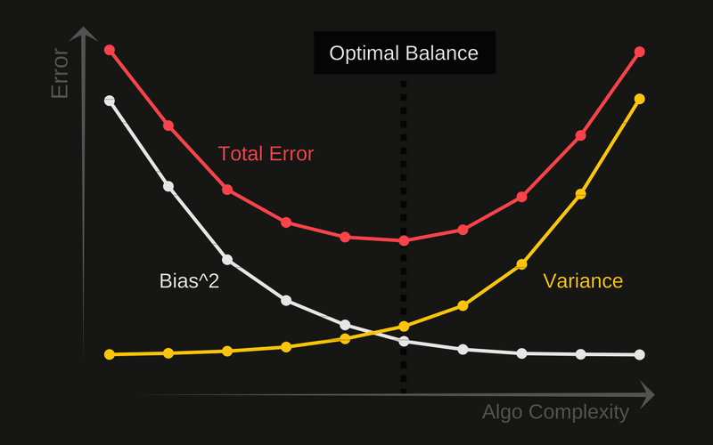
Total Error
To build a good predictive model, you'll need to find a balance between bias and variance that minimizes the total error.
Total Error = Bias^2 + Variance + Irreducible Error
Machine learning processes find that optimal balance:

Slide 15
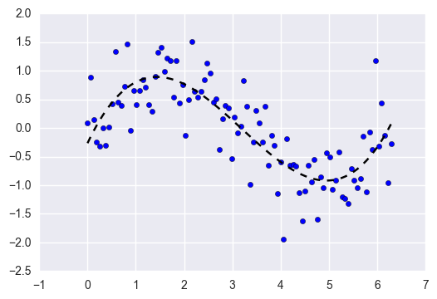
Proper Fitting
A proper machine learning workflow includes:
Separate training and test sets
Trying appropriate algorithms (No Free Lunch)
Fitting model parameters
Tuning impactful hyperparameters
Proper performance metrics
Systematic cross-validation
An optimal balance of bias and variance leads to a model that is neither overfit nor underfit:
This is the ultimate goal of supervised machine learning - to isolate the signal from the dataset while ignoring the noise!

Slide 16
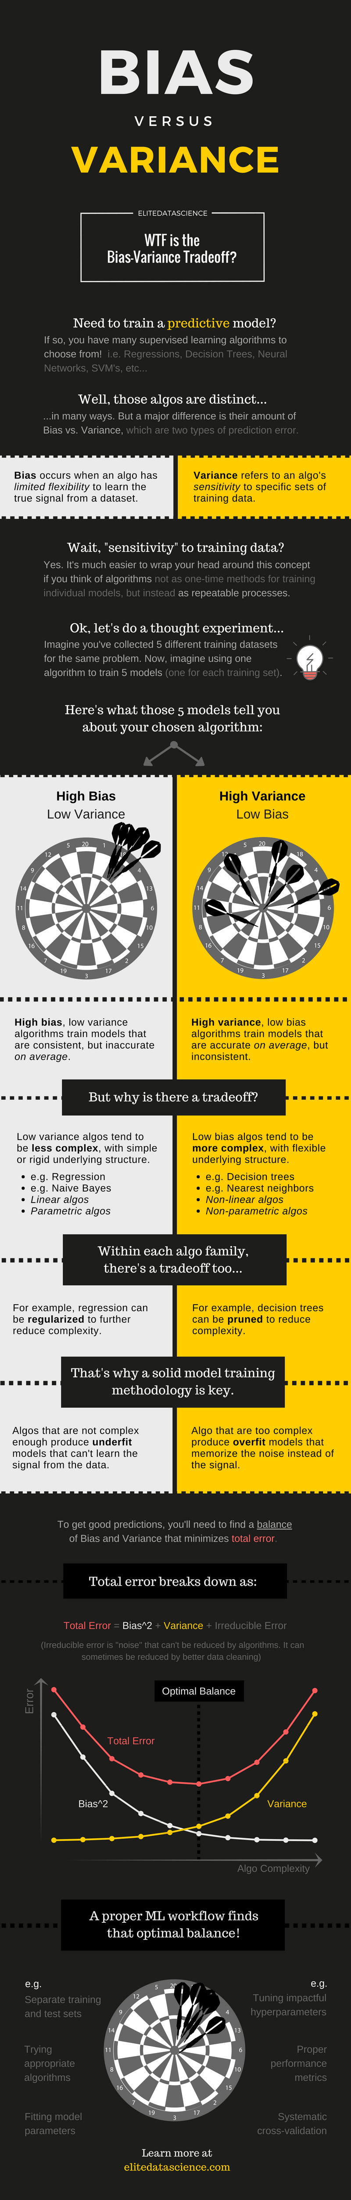
Bias - Variance

Slide 17
Under fitting
When the complexity of the model is too less for it to learn the data that is given as input, the model is said to “Underfit”.
In other words, the excessively simple model fails to “Learn” the intricate patterns and underlying trends of the given dataset.
Underfitting occurs for a model with Low Variance and High Bias.

Slide 18
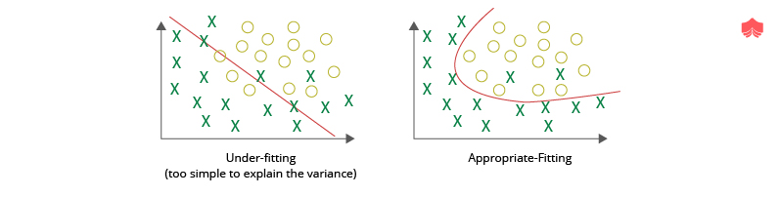
Under fitting data visualization-classification
As shown in the figure below, the model is trained to classify between the circles and crosses.
However, it is unable to do so properly due to the straight line, which fails to properly classify either of the two classes.

Slide 19
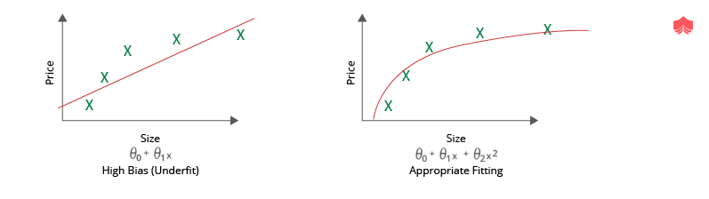
Under fitting data visualization-regression
As shown in the figure below, the data points are laid out in a given pattern, but the model is unable to “Fit” properly to the given data due to low model complexity.

Slide 20
Detect Under fitting
Training and Validation Loss: If the model is underfitting, the loss for both training and validation will be significantly high. In terms of Deep Learning, the loss will not decrease at the rate that it is supposed to if the model has reached saturation or is underfitting.
Over Simplistic Prediction Graph: If a graph is plotted showing the data points and the fitted curve, and the curve is over-simplistic, then the model is suffering from underfitting. A more complex model is to be tried out.
Classification: A lot of classes will be misclassified in the training set as well as the validation set. On data visualization, the graph would indicate that if there was a more complex model, more classes would have been correctly classified.
Regression: The final “Best Fit” line will fail to fit the data points in an effective manner. On visualization, it would clearly seem that a more complex curve can fit the data better.

Slide 21
Prevent Underfitting
Train Longer: Since underfitting means less model complexity, training longer can help in learning more complex patterns. This is especially true in terms of Deep Learning.
Train a more complex model: The main reason behind the model to underfit is using a model of lesser complexity than required for the data. Hence, the most obvious fix is to use a more complex model. In terms of Deep Learning, a deeper network can be used.
Obtain more features: If the data set lacks enough features to get a clear inference, then Feature Engineering or collecting more features will help fit the data better.
Decrease Regularization: Regularization is the process that helps Generalize the model by avoiding overfitting. However, if the model is learning less or underfitting, then it is better to decrease or completely remove Regularization techniques so that the model can learn better.
New Model Architecture: Finally, if none of the above approaches work, then a new model can be used, which may provide better results.

Slide 22
Over fitting
When the complexity of the model is too high as compared to the data that it is trying to learn from, the model is said to “Overfit”.
In other words, with increasing model complexity, the model tends to fit the Noise present in data (eg. Outliers). The model learns the data too well and hence fails to Generalize.
Overfitting occurs for a model with High Variance and Low Bias.

Slide 23
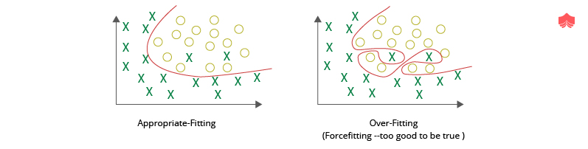
Over fitting data visualization-classification
As shown in the figure below, the model is trained to classify between the circles and crosses, and unlike last time, this time the model learns too well.
It even tends to classify the noise in the data by creating an excessively complex model (right).

Slide 24
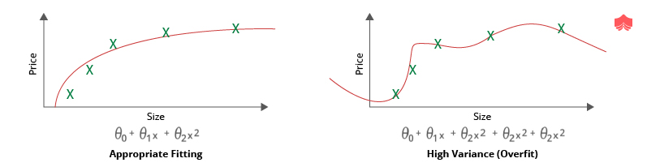
Over fitting data visualization-regression
As shown in the figure below, the data points are laid out in a given pattern, and instead of determining the least complex model that fits the data properly, the model on the right has fitted the data points too well when compared to the appropriate fitting (left).

Slide 25
Detect Over fitting
Training and Validation Loss: A very low training loss but a high validation loss would signify that the model is overfitting. Additionally, in Deep Learning, if the training loss keeps on decreasing but the validation loss remains stagnant or starts to increase, it also signifies that the model is overfitting.
Too Complex Prediction Graph: If a graph is plotted showing the data points and the fitted curve, and the curve is too complex to be the simplest solution which fits the data points appropriately, then the model is overfitting.
Classification: If every single class is properly classified on the training set by forming a very complex decision boundary, then there is a good chance that the model is overfitting.
Regression: If the final “Best Fit” line crosses over every single data point by forming an unnecessarily complex curve, then the model is likely overfitting.

Slide 26
Prevent Over fitting
Early Stopping during Training: This is especially prevalent in Deep Learning. Allowing the model to train for a high number of epochs (iterations) may lead to overfitting. Hence it is necessary to stop the model from training when the model has started to overfit. This is done by monitoring the validation loss and stopping the model when the loss stops decreasing over a given number of epochs (or iterations).
Train with more data: Often, the data available for training is less when compared to the model complexity. Hence, in order to get the model to fit appropriately, it is often advisable to increase the training dataset size.
Train a less complex model: As mentioned earlier, the main reason behind overfitting is excessive model complexity for a relatively less complex dataset. Hence it is advisable to reduce the model complexity in order to avoid overfitting. For Deep Learning, the model complexity can be reduced by reducing the number of layers and neurons.

Slide 27
Prevent Over fitting
Remove features: As a contrast to the steps to avoid underfitting, if the number of features is too many, then the model tends to overfit. Hence, reducing the number of unnecessary or irrelevant features often leads to a better and more generalized model. Deep Learning models are usually not affected by this.
Regularization: Regularization is the process of simplification of the model artificially, without losing the flexibility that it gains from having a higher complexity. With the increase in regularization, the effective model complexity decreases and hence prevents overfitting.
Ensembling: Ensembling is a Machine Learning method which is used to combine the predictions from multiple separate models. It reduces the model complexity and reduces the errors of each model by taking the strengths of multiple models. Out of multiple ensembling methods, two of the most commonly used are Bagging and Boosting.

Slide 28
Performance Metrices
Classification Accuracy
Confusion Matrix
Area under Curve
F1 Score
Mean Absolute Error
Mean Squared Error

Slide 29

Classification Accuracy
It is the ratio of number of correct predictions to the total number of input samples.
It works well only if there are equal number of samples belonging to each class.
It works well only if there are equal number of samples belonging to each class.
The real problem arises, when the cost of misclassification of the minor class samples are very high.
If we deal with a rare but fatal disease, the cost of failing to diagnose the disease of a sick person is much higher than the cost of sending a healthy person to more tests.

Slide 30
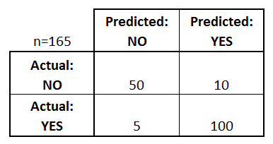
Confusion Matrix
Confusion Matrix as the name suggests gives us a matrix as output and describes the complete performance of the model.
Lets assume we have a binary classification problem.
We have some samples belonging to two classes : YES or NO.
Also, we have our own classifier which predicts a class for a given input sample.
On testing our model on 165 samples , we get the following result

Slide 31
Confusion Matrix
There are 4 important terms :
True Positives : The cases in which we predicted YES and the actual output was also YES.
True Negatives : The cases in which we predicted NO and the actual output was NO.
False Positives : The cases in which we predicted YES and the actual output was NO.
False Negatives : The cases in which we predicted NO and the actual output was YES.

Slide 32


Confusion Matrix
Accuracy for the matrix can be calculated by taking average of the values lying across the “main diagonal” i.e
Confusion Matrix forms the basis for the other types of metrics.

Slide 33
Area under Curve
Area Under Curve(AUC) is one of the most widely used metrics for evaluation.
It is used for binary classification problem.
AUC of a classifier is equal to the probability that the classifier will rank a randomly chosen positive example higher than a randomly chosen negative example.
Before defining AUC, let us understand two basic terms :
Sensitivity
Specificity

Slide 34

Area under Curve
True Positive Rate (Sensitivity) : True Positive Rate is defined as TP/ (FN+TP). It corresponds to the proportion of positive data points that are correctly considered as positive, with respect to all positive data points.
True Negative Rate (Specificity) : True Negative Rate is defined as TN / (FP+TN). It corresponds to the proportion of negative data points that are correctly considered as negative, with respect to all negative data points.
False Positive Rate : False Positive Rate is defined as FP / (FP+TN). It corresponds to the proportion of negative data points that are mistakenly considered as positive, with respect to all negative data points.

Slide 35
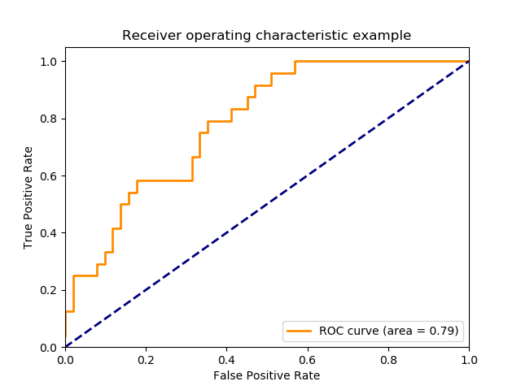
Area under Curve
False Positive Rate and True Positive Rate both have values in the range [0, 1].
FPR and TPR both are computed at varying threshold values such as (0.00, 0.02, 0.04, …., 1.00) and a graph is drawn.
AUC is the area under the curve of plot False Positive Rate vs True Positive Rate at different points in [0, 1].
As evident, AUC has a range of [0, 1]. The greater the value, the better is the performance of our model.

Slide 36

F1 Score
F1 Score is the Harmonic Mean between precision and recall.
The range for F1 Score is [0, 1].
It tells you how precise your classifier is (how many instances it classifies correctly), as well as how robust it is (it does not miss a significant number of instances).
High precision but lower recall, gives you an extremely accurate, but it then misses a large number of instances that are difficult to classify.
The greater the F1 Score, the better is the performance of our model. Mathematically, it can be expressed as

Slide 37
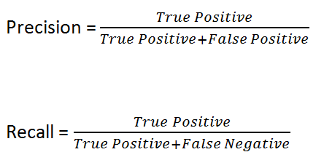
F1 Score
F1 Score tries to find the balance between precision and recall.
Precision : It is the number of correct positive results divided by the number of positive results predicted by the classifier.
Recall : It is the number of correct positive results divided by the number of all relevant samples (all samples that should have been identified as positive).

Slide 38

Mean Absolute Error
Mean Absolute Error is the average of the difference between the Original Values and the Predicted Values.
It gives us the measure of how far the predictions were from the actual output.
However, they don’t gives us any idea of the direction of the error i.e. whether we are under predicting the data or over predicting the data.
Mathematically, it is represented as :

Slide 39

Mean Squared Error
Mean Squared Error(MSE) is quite similar to Mean Absolute Error, the only difference being that MSE takes the average of the square of the difference between the original values and the predicted values.
The advantage of MSE being that it is easier to compute the gradient, whereas Mean Absolute Error requires complicated linear programming tools to compute the gradient.
As, we take square of the error, the effect of larger errors become more pronounced then smaller error, hence the model can now focus more on the larger errors.

Slide 40
References
Books and Journals
Understanding Machine Learning: From Theory to Algorithms by Shai Shalev-Shwartz and Shai Ben-David-Cambridge University Press 2014
Introduction to machine Learning – the Wikipedia Guide by Osman Omer.
Video Link-
https://www.youtube.com/watch?v=9f-GarcDY58
https://www.youtube.com/watch?v=GwIo3gDZCVQ
Web Link-
https://www.knowledgehut.com/blog/data-science/overfitting-and-underfitting-in-machine-learning
https://elitedatascience.com/overfitting-in-machine-learning
https://medium.com/greyatom/what-is-underfitting-and-overfitting-in-machine-learning-and-how-to-deal-with-it-6803a989c76

Slide 41
THANK YOU

